Slide 1
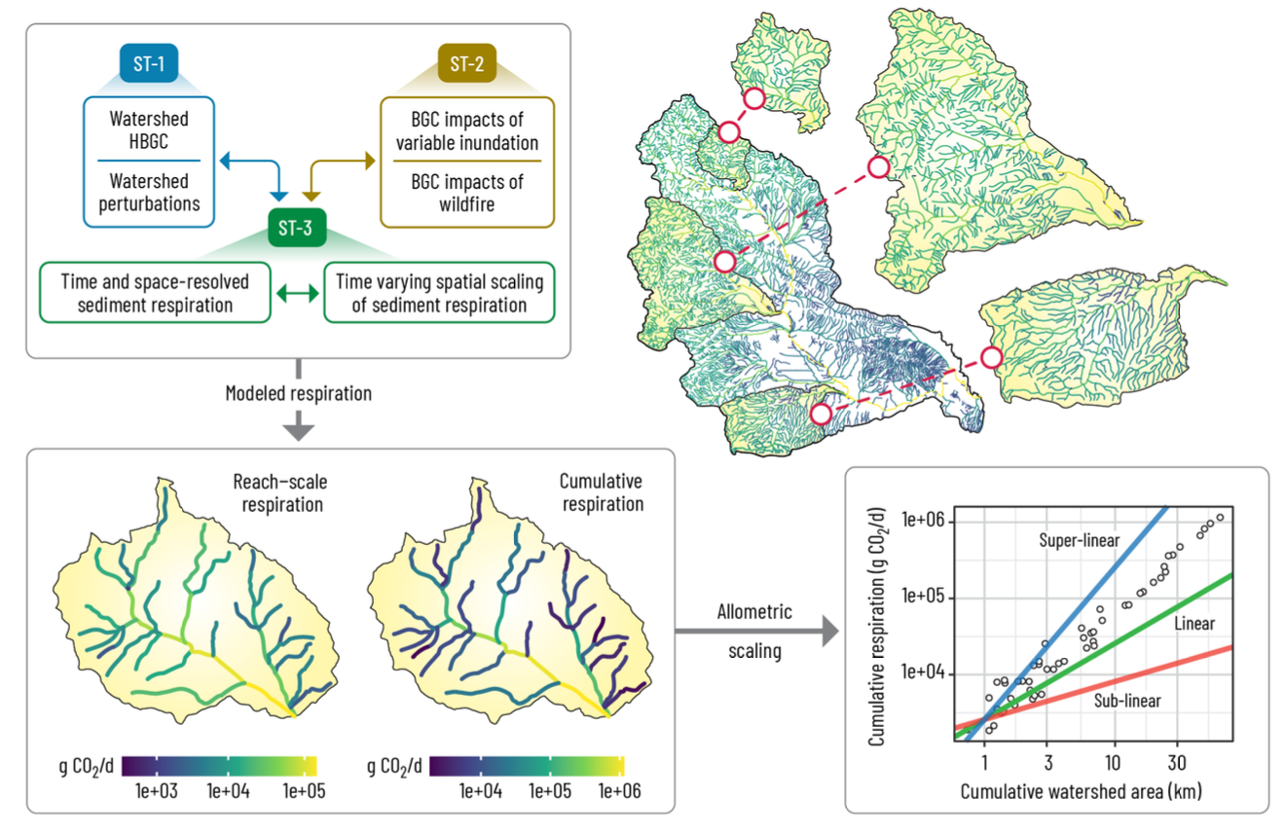
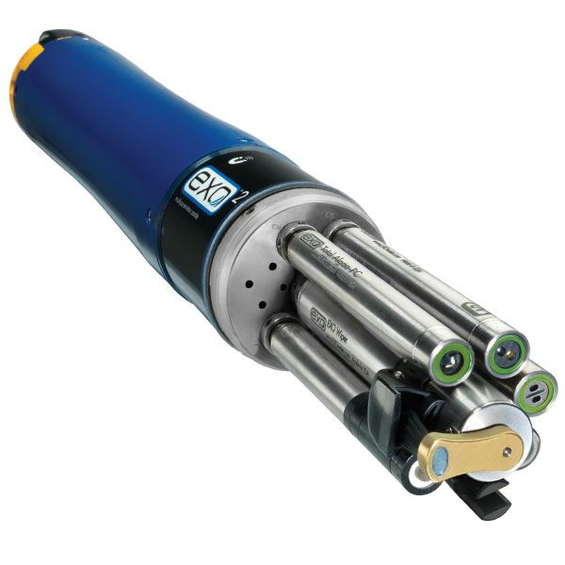
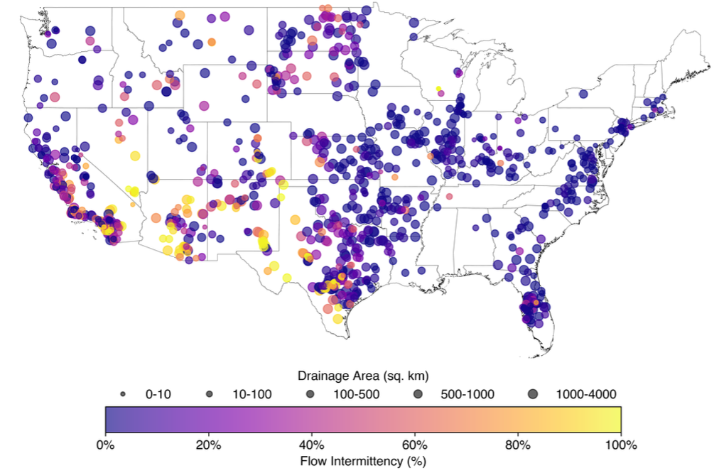
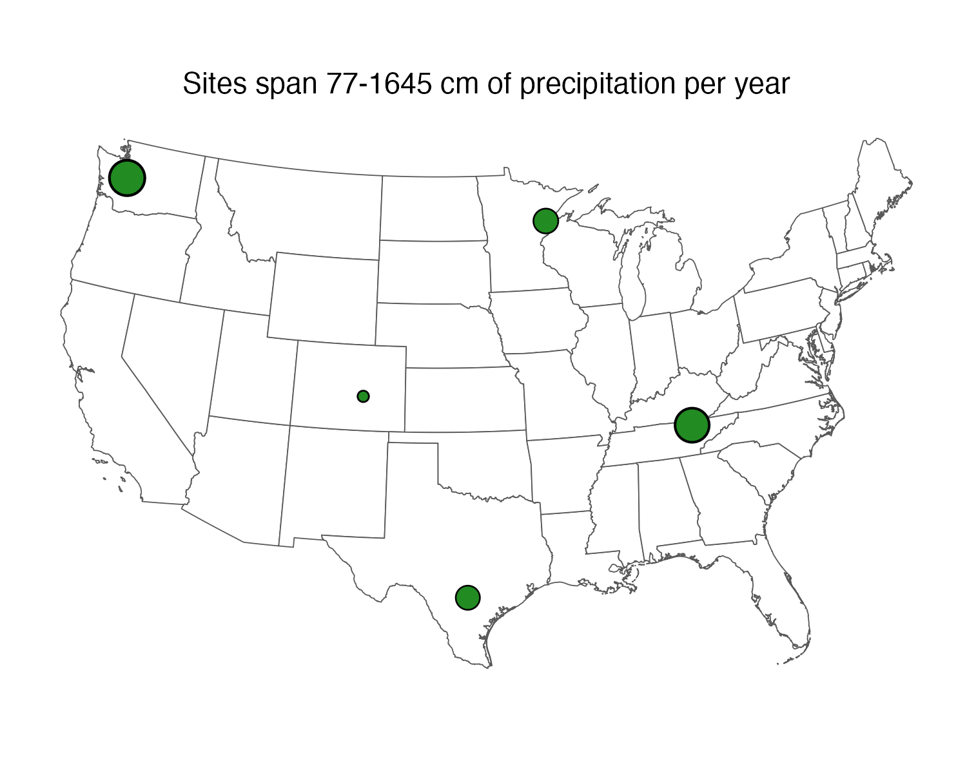
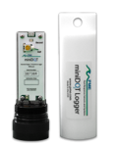
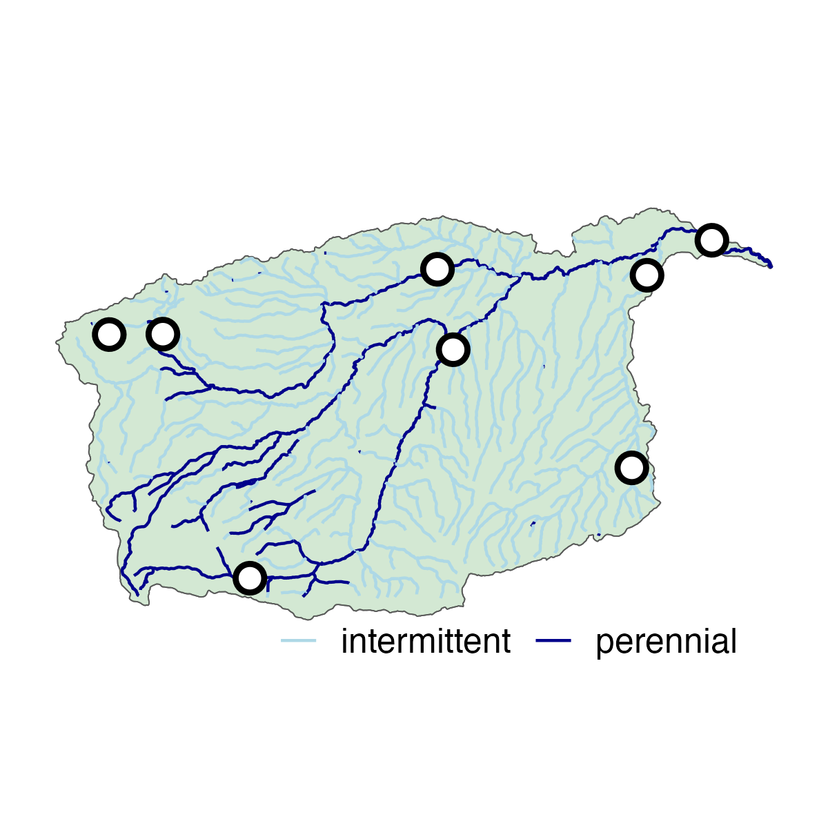
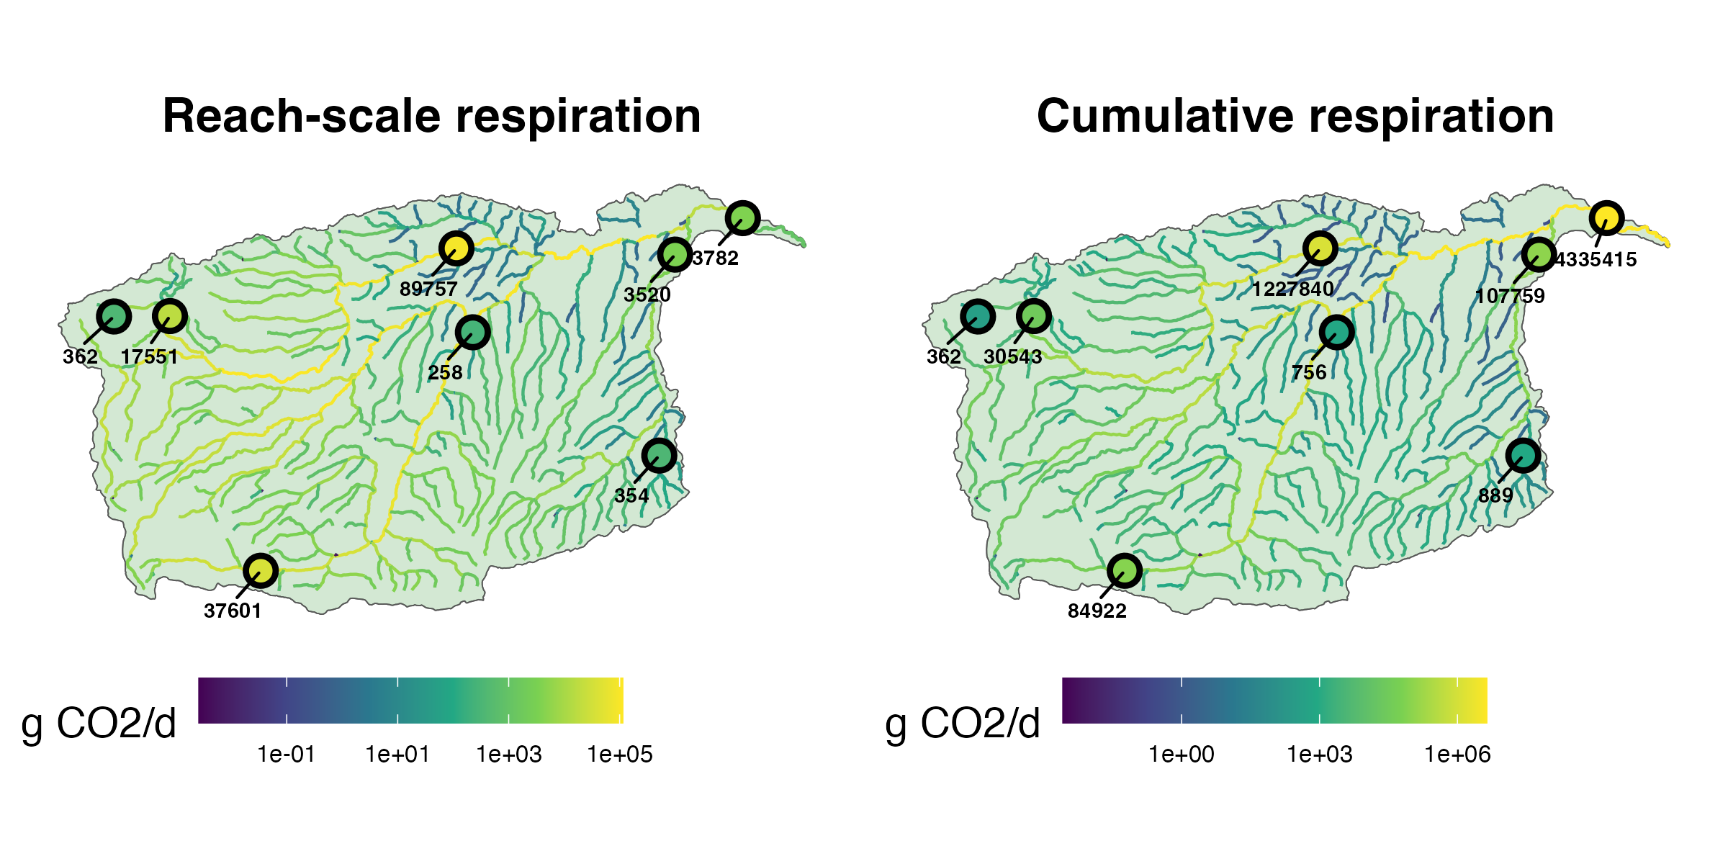
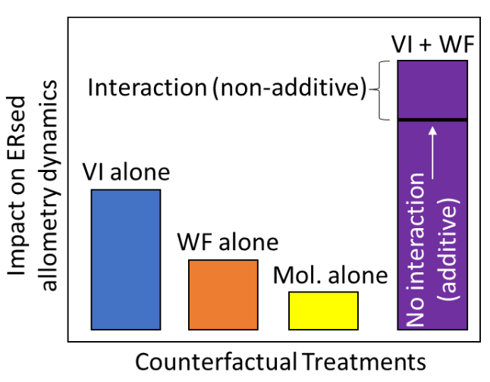
1. Knowledge transfer to ST-3B
2. Watershed and reach selection
3. Sensor deployments
4. Allometric scaling
ST-1A: watershed selection
Example: VI alone
DO and pressure at all sites
Water quality at highest-order site
streamMetabolizer
ST-3A: Perturbation
8 sites x 5 watersheds

